Slide 1
research agent ai
CAPSTONE PROJECT
Presented By:
Student name : Raj Kumar Vishwakarma
College Name & Department : Jharkhand Rai University Ranchi B . tech (CSE)

Slide 2
OUTLINE
Problem Statement
Technology used
Wow factor
End users
Result
Conclusion
Git-hub Link
Future scope
IBM Certifications

Slide 3

Problem Statement
Researchers and students face challenges in tracking and reviewing the ever-growing volume of academic papers and data.
Proposed Solution: An AI Research Agent using NLP and RAG that searches, summarizes, and organizes academic content, recommends papers, and identifies research gaps using IBM Granite model.

Slide 4
Technology used
IBM cloud lite services
A free-tier offering of IBM Cloud that allows users to build and deploy lightweight applications with limited resources.
Natural Language Processing (NLP)
A branch of AI that enables machines to understand, interpret, and respond to human language.
Retrieval Augmented Generation (RAG)
A technique that enhances AI responses by retrieving relevant information from a knowledge base before generating an answer.
IBM Granite model
A powerful foundation model from IBM trained on diverse data to perform a variety of language understanding and generation tasks.
Vector Indexing for RAG
A method of storing and searching document embeddings efficiently to enable fast and relevant information retrieval in RAG systems.

Slide 5
IBM cloud services used
IBM Cloud Watsonx AI Studio
A collaborative environment in IBM Cloud for building, training, and deploying AI models using foundation models like Granite.
IBM Cloud Watsonx.AI runtime
A managed runtime on IBM Cloud that hosts and executes foundation models with scalability and security.
IBM Cloud Agent Lab
An interactive lab interface within Watsonx for developing, testing, and refining AI agents using Granite and custom logic.
IBM Granite foundation model
IBM’s large-scale, enterprise-grade language model designed for diverse generative AI tasks such as summarization, Q&A, and content generation.
IBM Cloud Object Storage
A scalable, durable cloud storage service for storing and accessing unstructured data like documents, vectors, and models.

Slide 6

Wow factors
This AI-powered agent transforms how researchers interact with scholarly information. It significantly reduces the time spent on literature reviews, improves the quality of research insights by leveraging contextual understanding, and assists early-stage researchers in finding a clear research direction. By making large volumes of academic knowledge more accessible and actionable, it also encourages interdisciplinary collaboration and knowledge reuse across fields.
Unique features:
Semantic search across research papers, journals, and datasets.
Auto-summarization of selected papers.
Citation and reference analysis to trace influence.
Paper recommendations based on current queries.
Collaboration mapping for co-authors or instructions.

Slide 7
End users
Academic Researchers
Accelerates the discovery of relevant literature and supports hypothesis generation.
Research Institutions and Universities
Enhances research quality and collaboration through intelligent automation.
Industry R&D Teams
Speeds up innovation cycles by surfacing cutting-edge findings and trends.
Educators
Aids in curating and summarizing academic content for effective teaching and course design.

Slide 8
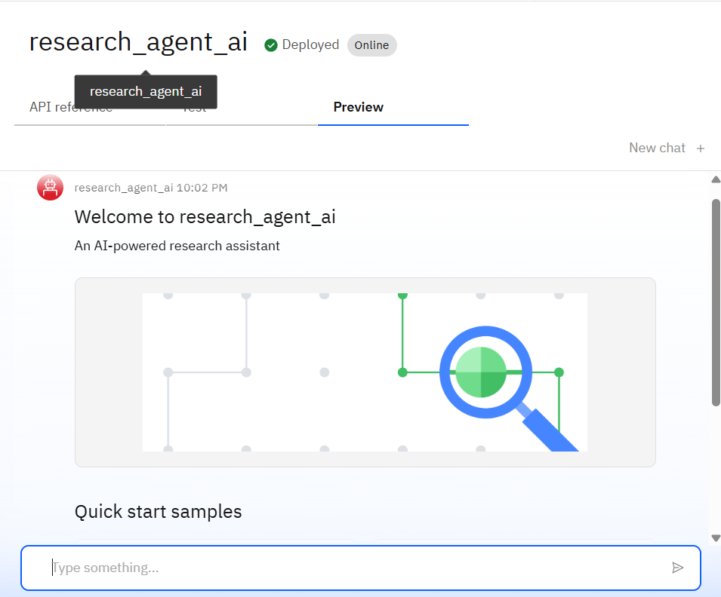
Results
Successfully deployed an interactive AI agent
Accepts user questions and returns research summaries

Slide 9
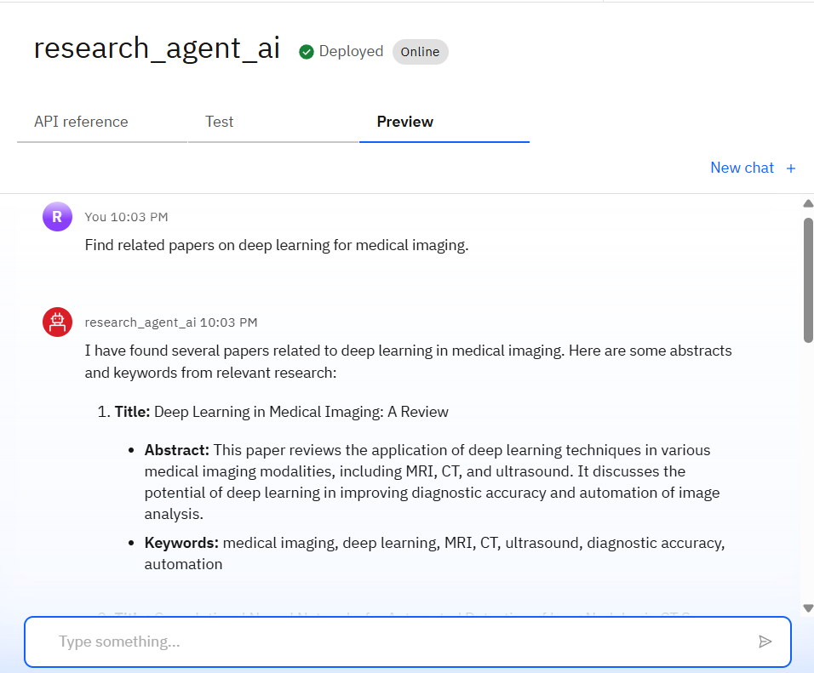
Results
Extracts answers from uploaded vector index
Integrated with IBM Granite model for reliable NLP generation
Performance tested in IBM Watsonx runtime

Slide 10
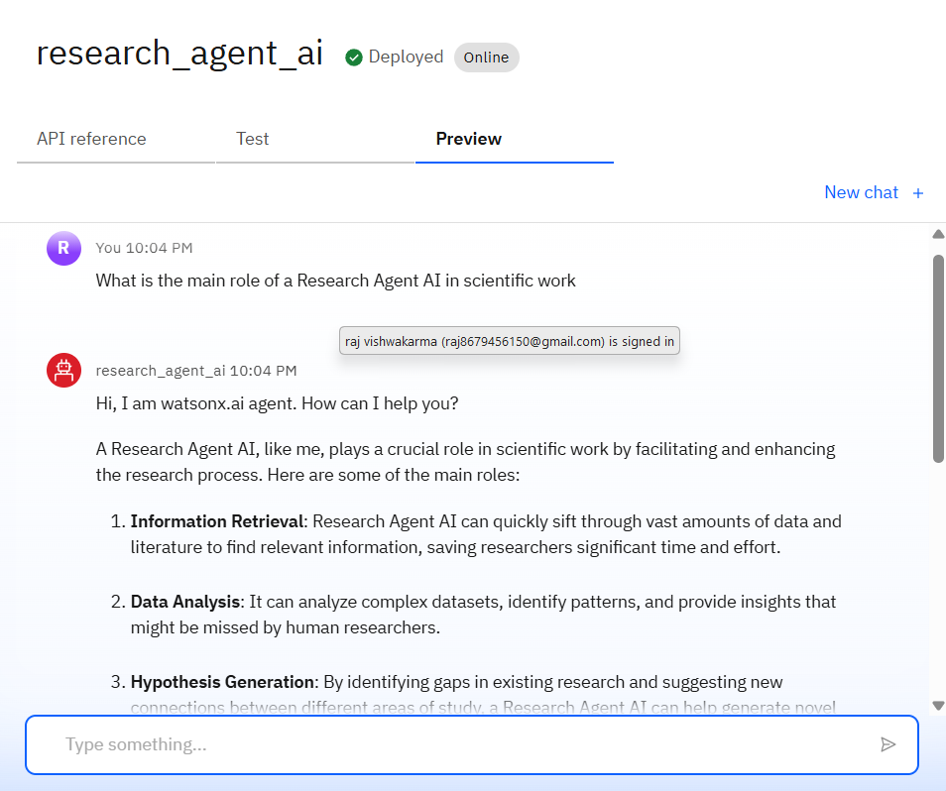
Results
This screenshot displays a live interaction with the Research Agent AI, deployed on IBM Watsonx.ai using the Granite foundation model. When asked “What is the main role of a Research Agent AI in scientific work?”, the agent responds intelligently, showcasing its core capabilities:
Information Retrieval – Quickly finding relevant literature.
Data Analysis – Identifying patterns and insights.
Hypothesis Generation – Suggesting new research directions.

Slide 11
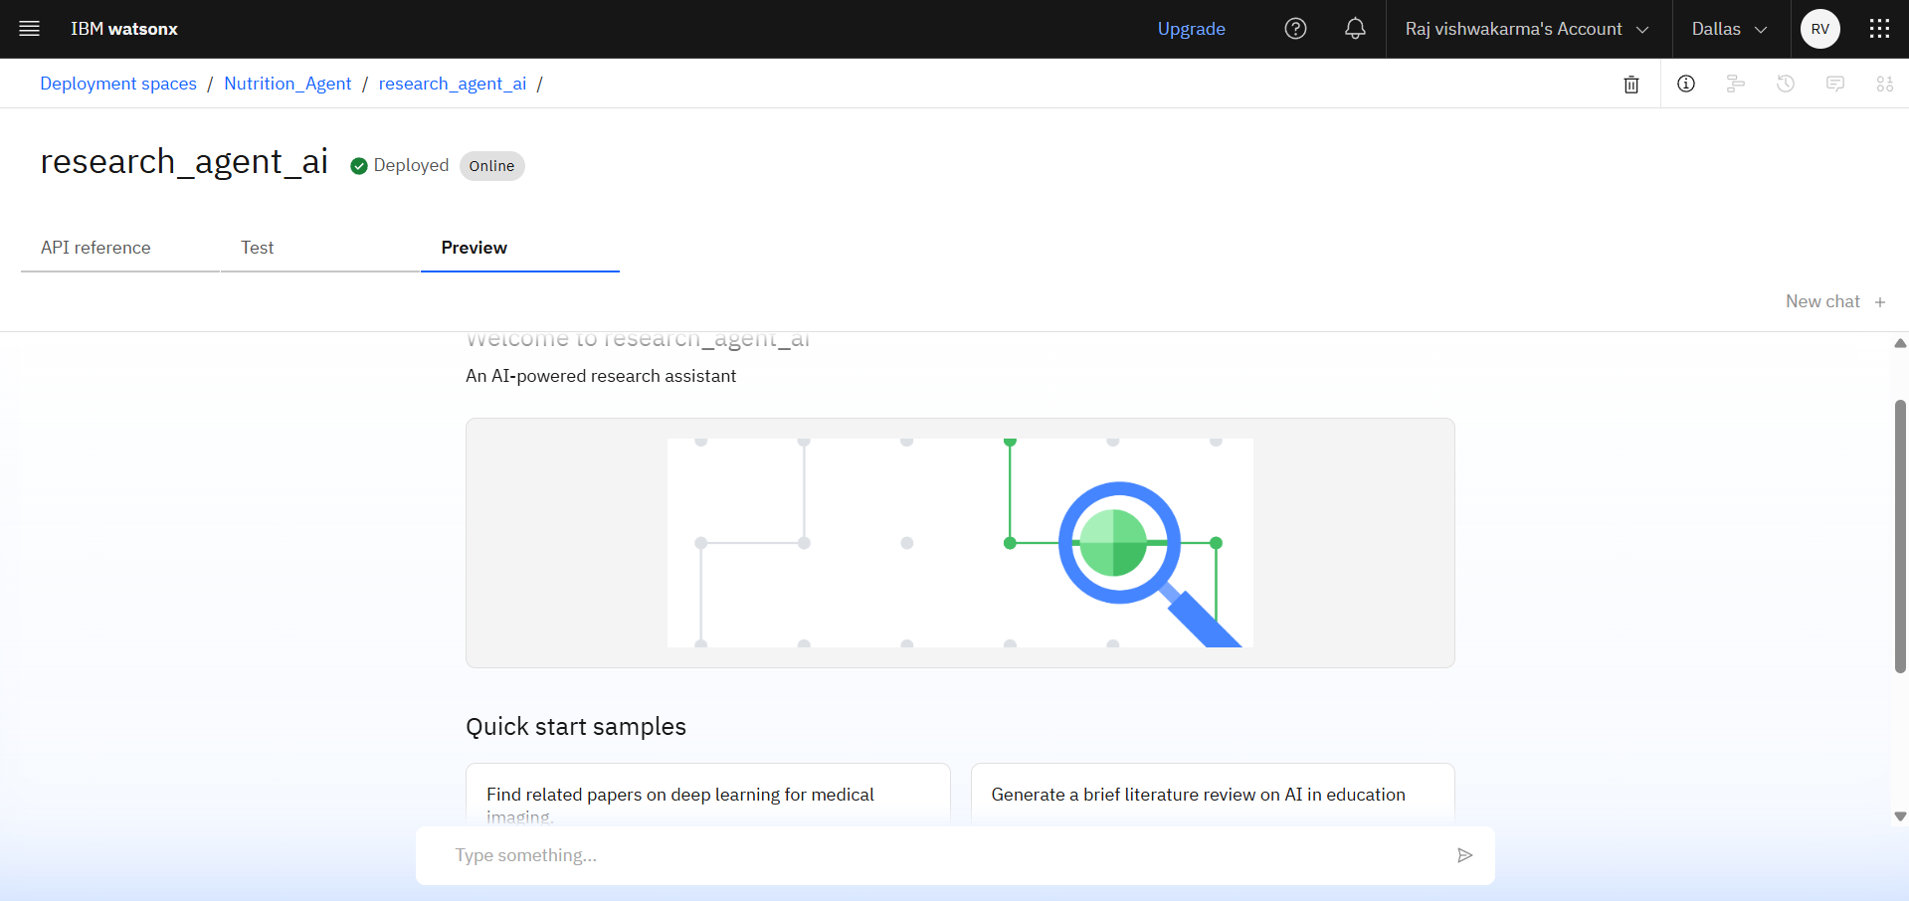
Results
Deployed AI Agent

Slide 12

Conclusion
Streamlines literature review by quickly retrieving and summarizing relevant academic content.
Automates citation and reference management, reducing manual effort.
Boosts research productivity for students, researchers, and R&D professionals.
Leverages IBM Granite for accurate, real-time understanding of complex queries.

Slide 13

Future scope
Multilingual Research Support
Voice-Activated Research Assistant
Real-Time Collaboration Features
Research Gap and Novel Topic Identification
Integration with Publishing Platforms
Novel Topic Identification
Auto Drafting Research Papers

Slide 14
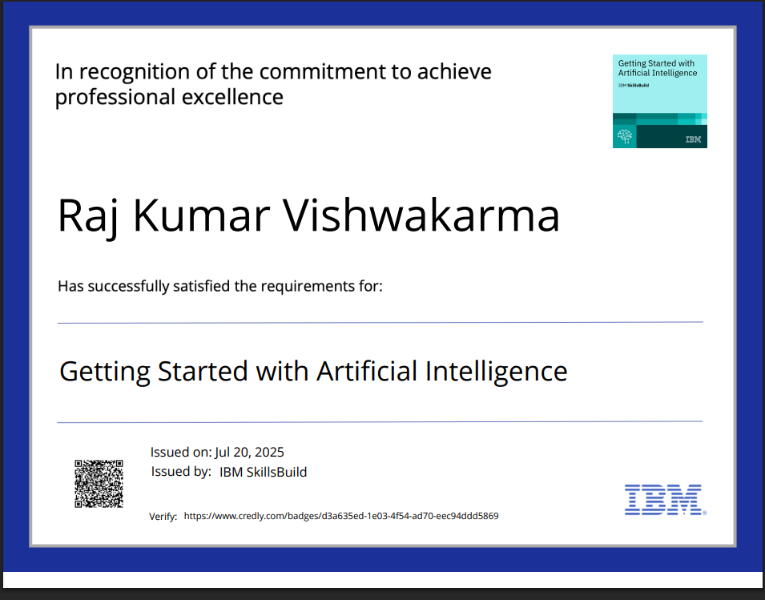
IBM Certifications
Screenshot/ credly certificate( getting started with AI)

Slide 15
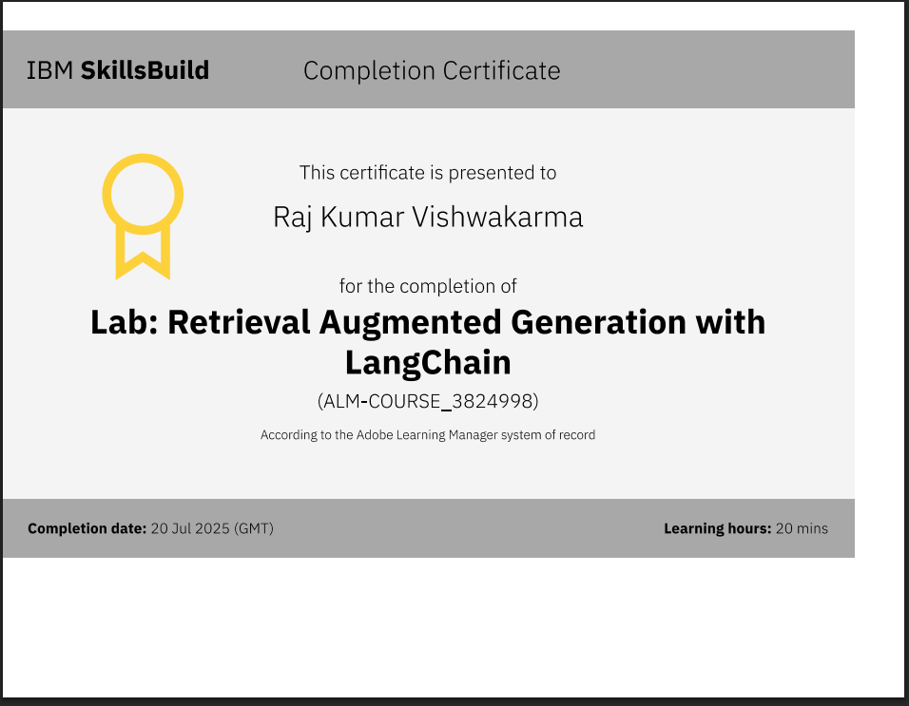
RAG LAB certificate

Slide 16
Git hub lik : https://https://github.com/rajvishwakarma90/Research-Agent--Ai

Slide 17
THANK YOU

